Slide 1
Conservation of Mass

Slide 2
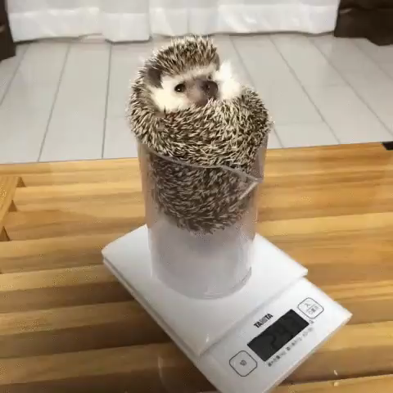
By the end of this lesson, you should be able to:
• | Define the Law of Conservation of Mass.
• | Understand that the number of atoms never change within a reaction.
• | Calculate the mass of products, given the mass of the reactants.

Slide 3

The mass of an object can be measured by weighing it.
Heavier objects have more mass.
Mass is determined by how many atoms are in an object.
For instance, an 8 billion atom block of gold has a greater mass than a 6 billion atom block of gold. It will weigh more on a set of scales.

Slide 4

In a chemical reaction, the mass of the starting substances (reactants) must be equal to the mass of the finishing substances (products).
This means we have the same number of atoms.
We also have the same type of atoms.
They are arranged differently now, because of the reaction, but no atoms have disappeared, appeared or changed to a different element.

Slide 5
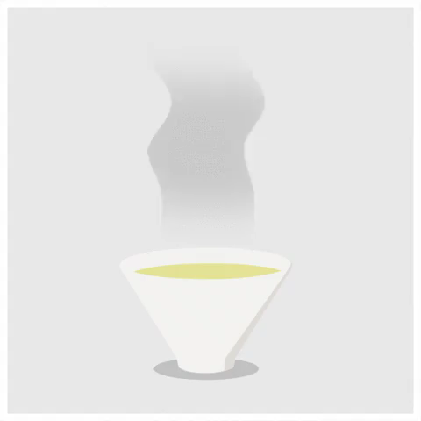
Have you ever noticed that when you leave a drink in the sun on a hot day there is less liquid in the glass when you come back?

Slide 6


Slide 7
The Law of Conservation of Mass states that during a chemical or physical change, such as evaporation, the amount of mass must remain the same.
This means that more mass cannot be produced by a physical change, and mass cannot be destroyed during a physical change.
That means that the liquid in the glass can't have disappeared or been destroyed. Instead, it must have gone somewhere.

Slide 8
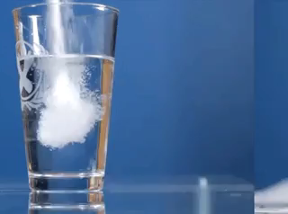
We'll use sugar and water to observe this idea of conservation of mass.
Using Conservation of Mass, if we add 5 g of sugar to 10 g of water, we know that in total we have 15g of reactants.
Because of the Law of Conservation of Mass, any reaction that occurs will produce 15g of products.

Slide 9
The Law of Conservation of Mass is true in any change.
We can use this law when looking at atoms being rearranged in a physical change, such as dissolving sugar in water.
When chemical bonds are broken and re-made (in a chemical reaction), nothing can be lost or destroyed and no new atoms can be created.

